Slide 1
PROJECT TITLE: ML Based Solution To Refine CAPTCHA
PIP4004 University Project
Review-2
Batch Number:
Roll Number | Student Name
Gnanavika M | 20211CSG0026
R Kamal Raj | 20211CSG0035
Shreyas DM | 20211CSG0005
Under the Supervision of,
Mr.Yamanappa
Assistant Professor
School of Computer Science & Engineering
Presidency University

Slide 2
Introduction
1.Background:
The Unique Identification Authority of India (UIDAI) manages multiple online portals for resident engagement.
Current security measures include CAPTCHA (Completely Automated Public Turing tests to tell Computers and Humans Apart) to prevent automated attacks.
The Unique Identification Authority of India (UIDAI) is responsible for implementing the Aadhaar project, which provides a unique identification number to residents of India.
2.Problem Statement:
CAPTCHA hinders user experience, leading to frustration and potential abandonment of services.
UIDAI seeks a passive solution that can effectively differentiate between human users and bots without intrusive CAPTCHA challenges.
The implementation of CAPTCHA can lead to frustration among users, particularly when they encounter difficult challenges or repeated prompts.

Slide 3
Literature Review
1.Traditional CAPTCHA:
Effective in blocking automated scripts but can be frustrating for users.
Accessibility challenges for individuals with disabilities.
2.Advancements:
hCaptcha and reCAPTCHA offer improved user experiences through image recognition tasks but still require user interaction.
3.Behavioral Biometrics:
Analyzes user behavior patterns (e.g., typing speed, mouse movements) for passive detection.
Raises privacy concerns due to extensive data collection.
4.Machine Learning Approaches:
Anomaly detection and interaction analysis show promise in identifying bot behavior.
Challenges include the need for substantial datasets and the risk of overfitting.

Slide 4
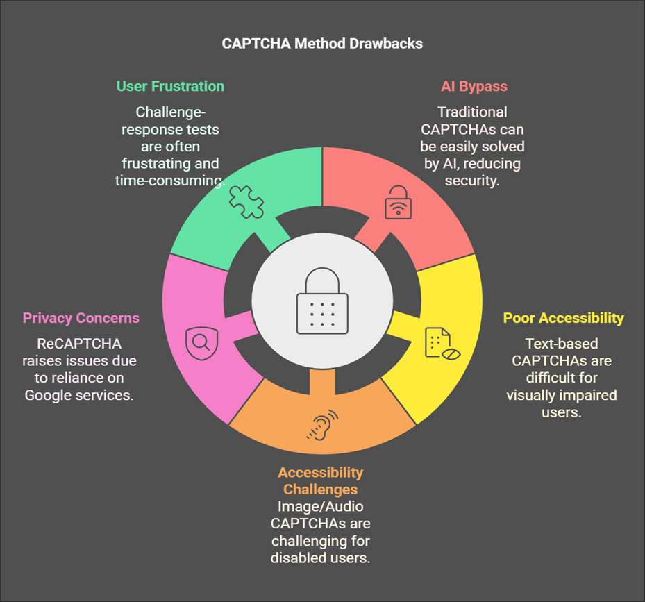
Literature Review

Slide 5
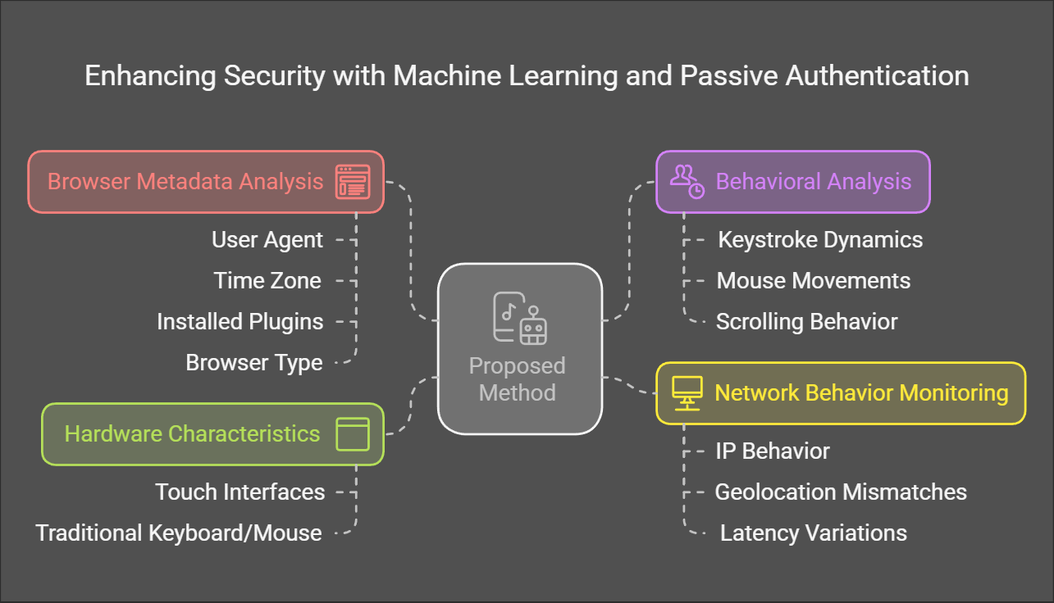
Proposed Method

Slide 6
Proposed Method
The proposed solution leverages machine learning and passive authentication techniques to enhance security while improving user experience. Key features include:
Browser metadata analysis: Extracts details such as user agent, time zone, installed plugins, and browser type.
Behavioral analysis: Captures user interaction patterns such as keystroke dynamics, mouse movements, and scrolling behavior.
Network behavior monitoring: Identifies anomalies in IP behavior, geolocation mismatches, and latency variations.
Hardware characteristics: Distinguishes between touch interfaces and traditional keyboard/mouse setups to identify human users.
The ML model processes these parameters in real-time to classify users as bots or humans. If uncertainty exists, minimal user interaction prompts are triggered to ensure accuracy.

Slide 7
Objectives
1.Identification and Selection of Environmental Parameters:
Define and capture a comprehensive set of parameters (e.g., mouse movement patterns, keystroke dynamics, browser characteristics) to differentiate between human users and bots ensuring robustness.
2.Development of a Passive Detection Mechanism:
Create a real-time analysis mechanism using machine learning algorithms to classify user interactions as human or bot-driven without active engagement, with intelligent prompts for minimal,non-intrusive user interactions if needed.
3.Implementation of a Pluggable Machine Learning Model:
Develop a modular and pluggable machine learning model for seamless integration with UIDAI's application stack, capable of continuous learning and adaptation to evolving bot behaviors while ensuring scalability and performance.
4.Adherence to Privacy and Compliance Standards:
Prioritize user privacy by implementing data anonymization techniques, ensuring secure data handling, providing transparency in data collection.

Slide 8
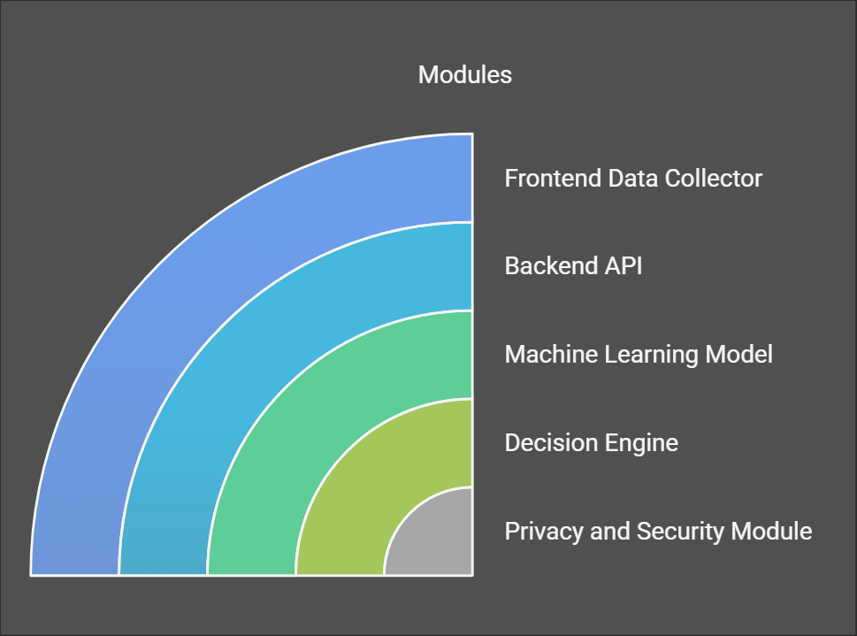
Methodology

Slide 9
Methodology
(i)Hardware and Software Used
Hardware:
A standard server or cloud-based infrastructure for hosting the backend machine learning model.
User devices (desktops, laptops, tablets, and smartphones) for testing the frontend
implementation.
Software:
Frontend Framework:React.js or TypeScript for building the user interface to capture
environmental parameters.
Backend Framework:Node.js or Python Flask for developing the server-side application.
Machine Learning Libraries:Scikit-learn, TensorFlow, or PyTorch for building and training the
machine learning model.
Database:MongoDB or PostgreSQL for storing user interaction data and model outputs.
Version Control: Git for source code management and collaboration.

Slide 10
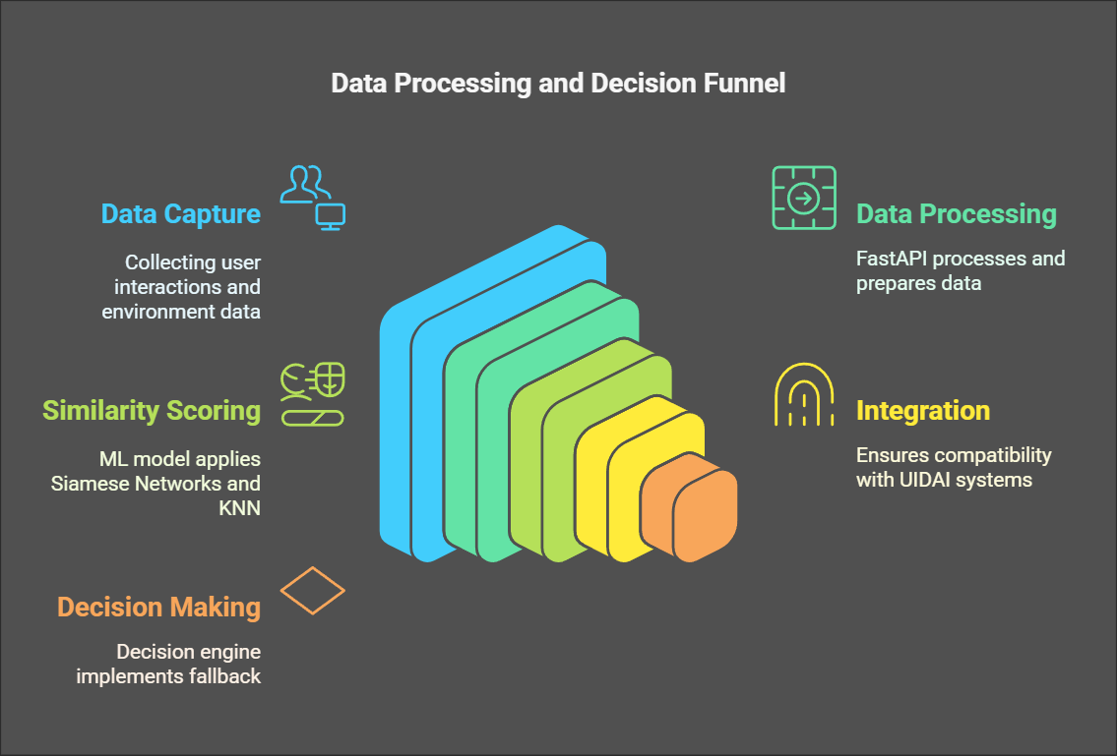
Methodology

Slide 11
Methodology
The design procedure for the proposed solution involves several key steps:
Requirement Analysis: Identify specific requirements, including environmental parameters (e.g., mouse movements, keystroke dynamics) and privacy policies.
Feature Selection: Define and select environmental parameters indicative of human versus bot interactions based on user behavior analysis.
Frontend Development: Implement the frontend application using a JavaScript framework (e.g., React.js) to capture parameters and ensure a seamless user experience.
Backend Development: Develop the backend application using Node.js or Python Flask to process captured data and interface with the machine learning model.
Machine Learning Model Development: Build and train a machine learning model to classify user interactions as human or bot-driven using appropriate algorithms.
Integration: Integrate frontend and backend components, setting up APIs for effective communication and model access.
Testing and Validation: Conduct thorough testing, including unit, integration, and user acceptance testing, to validate performance and accuracy.
Deployment: Deploy the validated solution in a production environment, ensuring compliance with UIDAI's privacy policies.
Monitoring and Maintenance: Continuously monitor system performance and update the model to adapt to new bot behaviors and attack patterns.

Slide 12
Timeline of Project
Task | Start Date | End Date | Duration
Research & Requirement Analysis | Feb 20, 2025 | Feb 26, 2025 | 1 Week
Data Collection & Feature Selection | Feb 27, 2025 | Mar 5, 2025 | 1 Week
Model Development & Training | Mar 6, 2025 | Mar 19, 2025 | 2 Weeks
Backend API Development | Mar 20, 2025 | Mar 26, 2025 | 1 Week
Frontend Data Collection Implementation | Mar 27, 2025 | Apr 9, 2025 | 2 Weeks
Integration & Testing | Apr 10, 2025 | Apr 17, 2025 | 1 Week
Deployment & Final Testing | Apr 18, 2025 | Apr 26, 2025 | 1 Week

Slide 13
Expected Outcomes
The development of a machine learning model-based solution to refine CAPTCHA for UIDAI's portals is expected to yield significant outcomes:
Enhanced User Experience: Replacing traditional CAPTCHA with a passive solution will lead to smoother interactions, reducing frustration and abandonment rates.
Effective Bot Detection: The solution will differentiate between human users and bots by analyzing environmental parameters, training the model to recognize human behavior patterns.
Minimal User Interaction: The system will prompt users for minimal, non-intrusive interactions if passive analysis is inconclusive, maintaining a positive user experience.
Scalable Architecture: The modular design of the machine learning model will allow easy integration with UIDAI's application stack and facilitate future updates.
Privacy Compliance: The solution will adhere to UIDAI's privacy policies, ensuring secure data handling, implementing data anonymization, and establishing user consent mechanisms.
Robust Security: By identifying and blocking bot traffic, the solution will enhance security against DoS and DDoS attacks.
Continuous Improvement: The system will include mechanisms for ongoing monitoring and updates to adapt to new bot behaviors.
Comprehensive Documentation: The project will produce thorough documentation and a well-structured codebase for future development and collaboration.

Slide 14
Conclusion
In conclusion, the development of a machine learning model-based solution to refine CAPTCHA for UIDAI's portals represents a significant advancement in enhancing user experience while ensuring robust security against automated threats.
By shifting to a passive detection approach, this solution facilitates seamless resident engagement with Aadhaar portals, reducing barriers to interaction.
It captures environmental parameters to differentiate between human users and bots, minimizing intrusive interactions and preserving user experience.
The modular architecture allows for easy integration with UIDAI's existing systems, ensuring scalability and adaptability to evolving threats.
The solution adheres to UIDAI's privacy policies, emphasizing data protection and fostering trust.
Expected outcomes include enhanced user satisfaction, improved security against DoS/DDoS attacks, and a framework for continuous monitoring of the machine learning model.
This project demonstrates the potential of AI and machine learning to create user-centric solutions that balance security and usability.
The successful implementation will contribute to UIDAI's mission of providing secure and efficient services, ultimately enhancing the effectiveness of the Aadhaar system.

Slide 15
References
1. Goodfellow, I., et al. (2014). "Generative Adversarial Networks."
https://arxiv.org/abs/1406.2661
2. Doshi, R., et al. (2018). "A Study on Automated CAPTCHA Solving."
https://arxiv.org/abs/1805.05910
3. Sivakorn, S., et al. (2016). "CAPTCHA Challenges in Modern Web Security."
https://www.usenix.org/conferences/technical-sessions/annual-technicalconference/2016/conference-program/presentation/sivakorn
4. Google Research Papers on ReCAPTCHA.
https://research.google/pubs/archive/45530.pdf
5. Various IEEE and ACM published works on bot detection using ML.
https://ieeexplore.ieee.org/Xplore/home.jsp
https://dl.acm.org

Slide 16
Thank You

